Slide 1


Library management
Group-7

Slide 2
Team members
Name
Ommkar sai mishra Satyajit Routray
Somnath Mahapatra Subham Tarasia
Cranes reg-
CL2025010601891092 CL2025010601923263
CL2025010601926495 CL20250106019293124

Slide 3
Introduction
Admin-Controlled Library Management System: A Java Swing application featuring secure login authentication and comprehensive tools for managing book inventory, member registrations, and borrowing/returning transactions through an intuitive graphical interface.

Slide 4


Background Processes
Login Check:
Validates "admin/admin" credentials before allowing access.
Data Handling:
Stores books/members in temporary memory (no database) use ar. Updates book status (borrowed/available) and member borrowing lists.
UI Updates:
Buttons trigger actions (e.g., "Add Book" opens input dialogs). Display area shows real-time lists of books/membrs
Basic Security:
Password field masks input (not secure long-term). Blocks empty inputs for book/member creation.
Limitation: Data resets when the app closes.

Slide 5


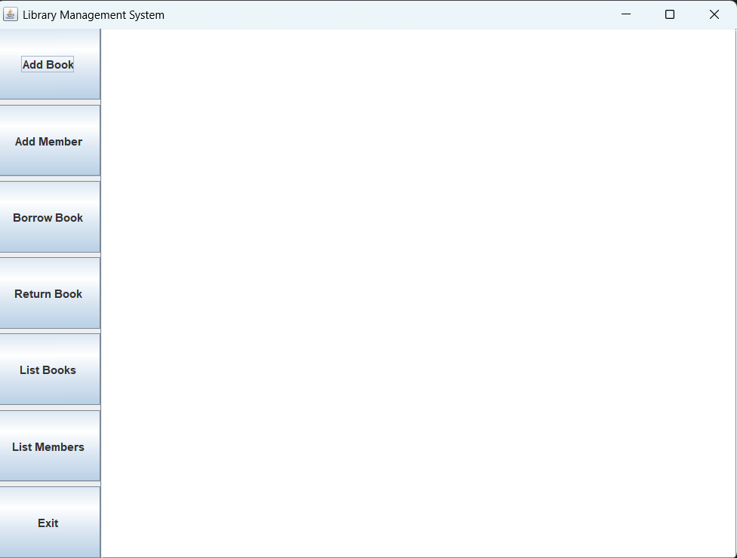
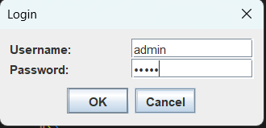
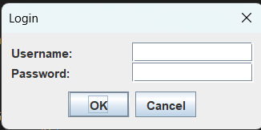
login page

Slide 6
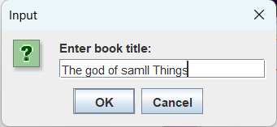
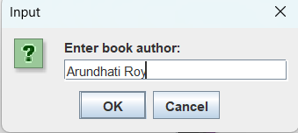
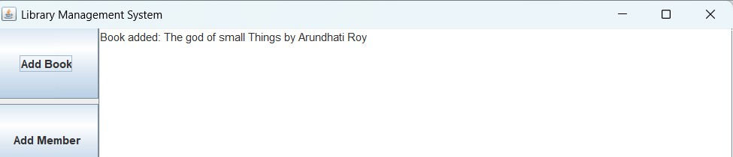
Add Book

Slide 7
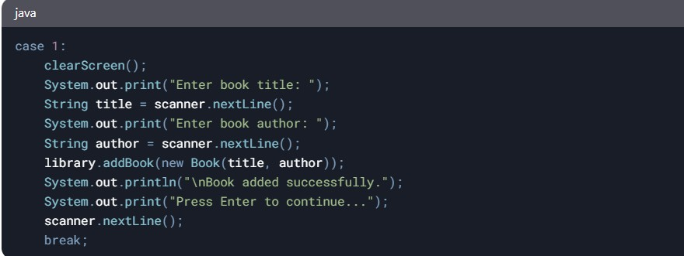
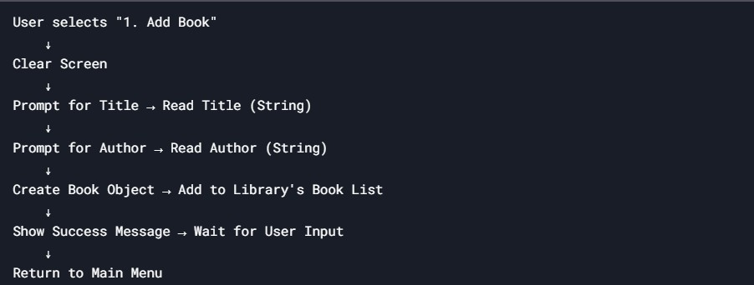
Code
Flow Diagram

Slide 8
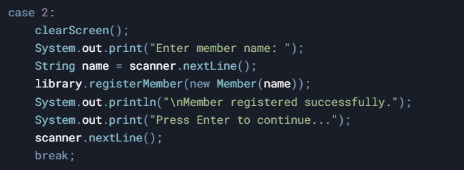
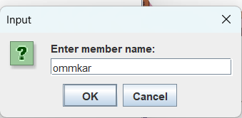
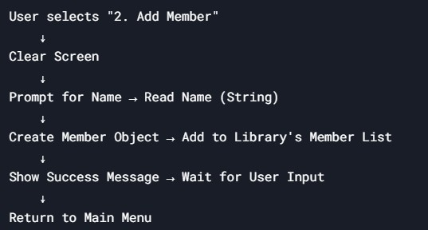
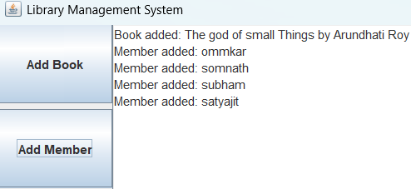
Add member

Slide 9
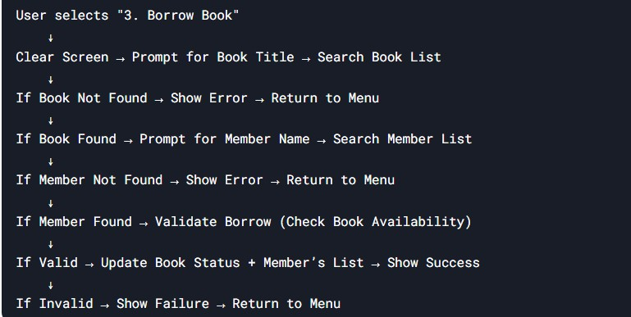
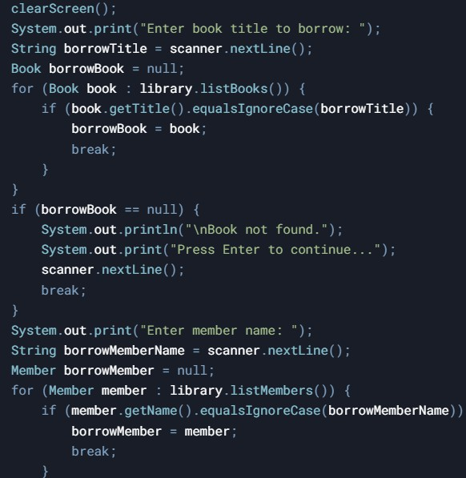
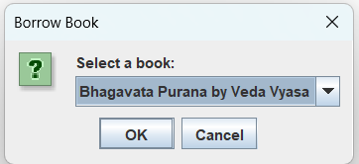
Borrow book

Slide 10
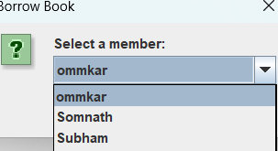
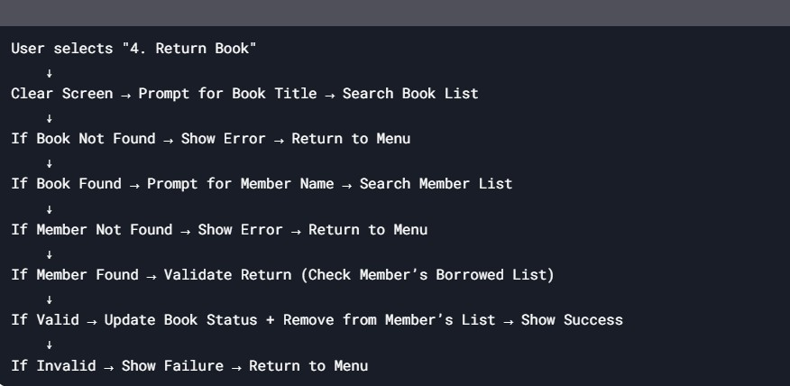
Return Book

Slide 11


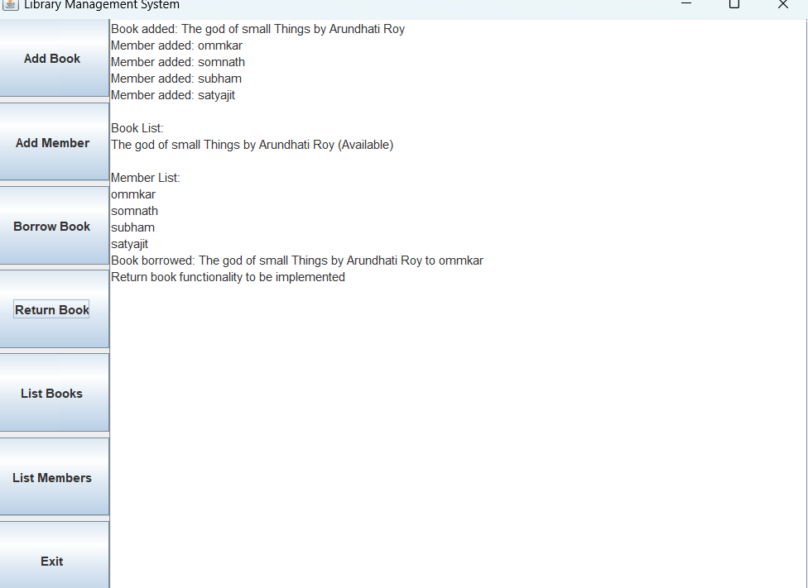
Full ui
Code for view -:
https://onlinegdb.com/vF-EiKqNj

Slide 12

THANK YOU

